Slide 1
Blowfish Encryption
PREPARED BY
NAFID FAHAM
ID :18101107

Slide 2
Topics
Introduction
Definition
General Structure
Usages and Examples
Image Encryption using Blowfish
Internal Procedure
Algorithm
Advantages and Disadvantages
Conclusion

Slide 3
Introduction and Definition
Information Security has become an important issue in data communication.
Blow Fish is a Symmetric Block Cipher.
It can be used for encryption and safeguarding data.
It was designed in 1993 by Bruce Blowfish

Slide 4
General Structure
It takes a variable-length key from 32bits to 448 bits.
64 bit block cipher .
Large key dependent S-boxes
Key dependent permutations
Diverse Mathematical Operations
Fiestel iterated block cipher

Slide 5
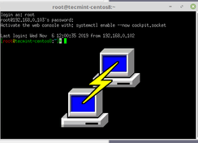


Usages and Examples
Password Management : Access Manager , Java PasswordSafe , Web Confidential
File/Disk Encryption : GnuPG, Bcrypt , Cryptoforge
Backup Tools : Symantec NetBackup, Backup for workgroups
Email Encryption : A-lock , SecuMail
Operating System : Linux , OpenBSD
Secure Shell (SSH) : OpenSSH , Putty
Image Processing Unit

Slide 6
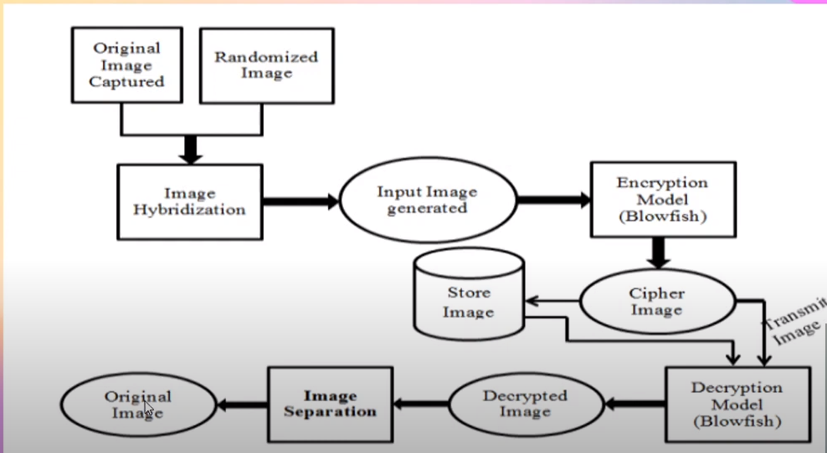
Image encryption using Blowfish

Slide 7
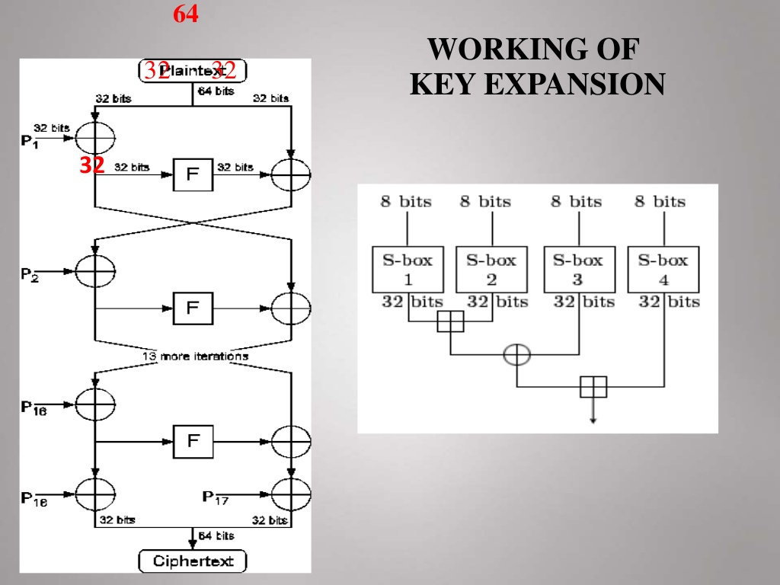
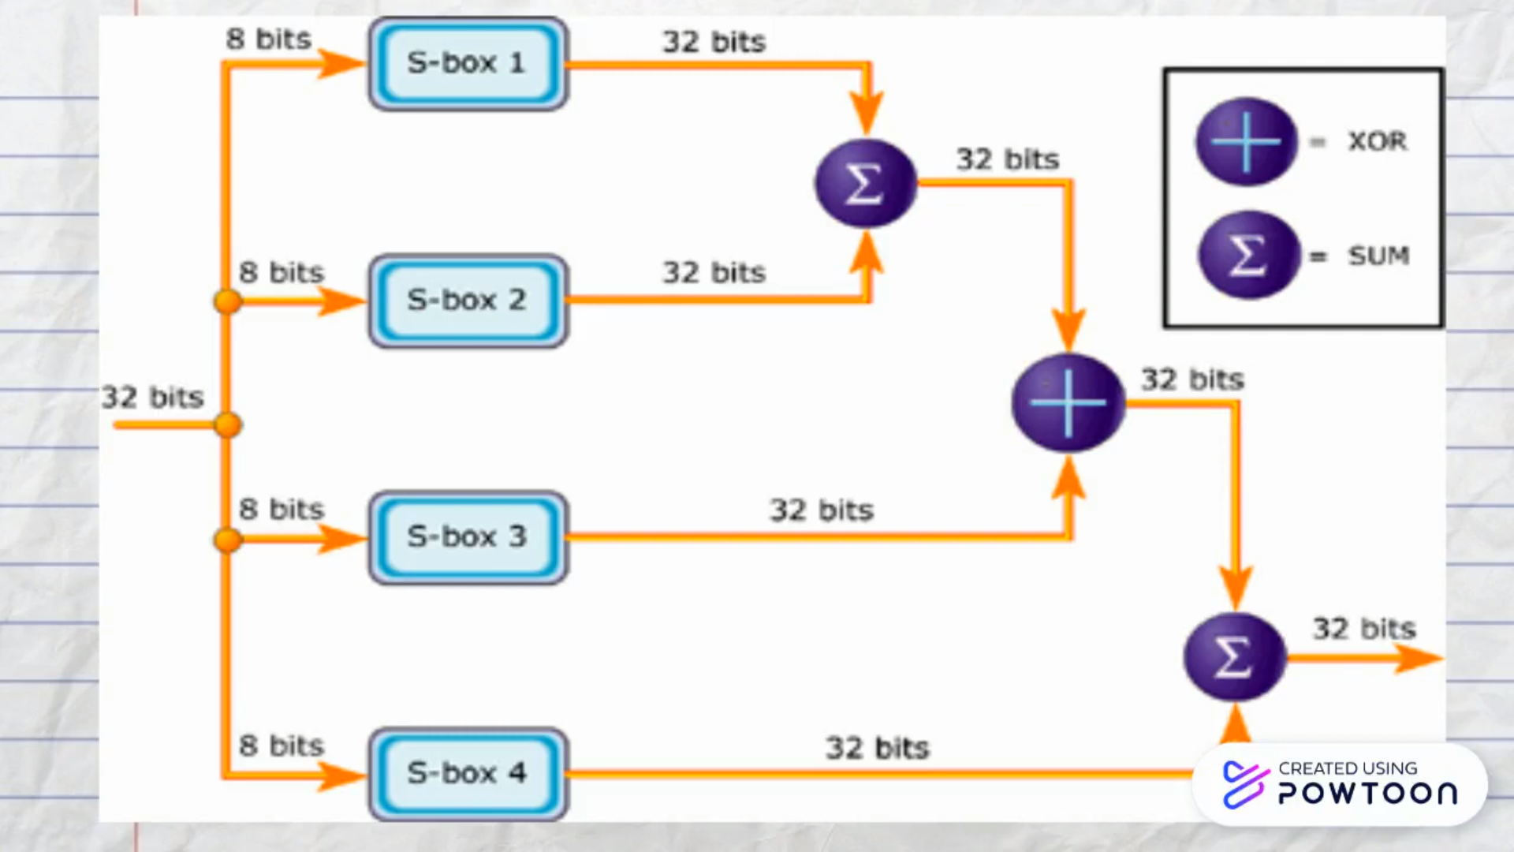
Internal Procedure
Input is 64 bit data element ,x
Divide x into two 32bit halves
For 16 Rounds perform operations ( Fiestel )

Slide 8
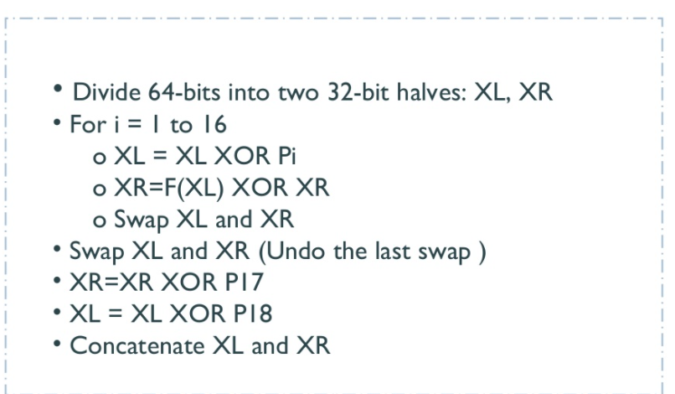
Algorithm

Slide 9
Advantages
License Free
More Secure
Improved performance
Less power consumption
Smaller Design size
At a time encryption and decryption can be performed

Slide 10
Disadvantages
The key schedule of Blowfish takes a long time.
Birthday attack can occur and compromise the encryption
Not suitable for all applications like packet switching , one-way has function.
TwoFish was introduced in favour of it

Slide 11
Conclusion
Encryption and Decryption are important aspects of all organizations for 4 main reasons :-
1.Authentication
2.Privacy
3.Regulatory Compliance
4.Security
BlowFish is common and effective
It is viable but not in all situation
Depends on situations

Slide 12
THANK YOU

